Slide 1
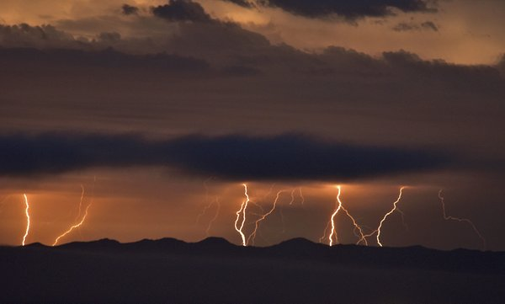



Bam! Lightning on Venus?
Claire H. Blaske, Dr. Joseph G. O’Rourke
Arizona State University
AZ Space Grant Symposium
April 22-23, 2022
1/11

Slide 2
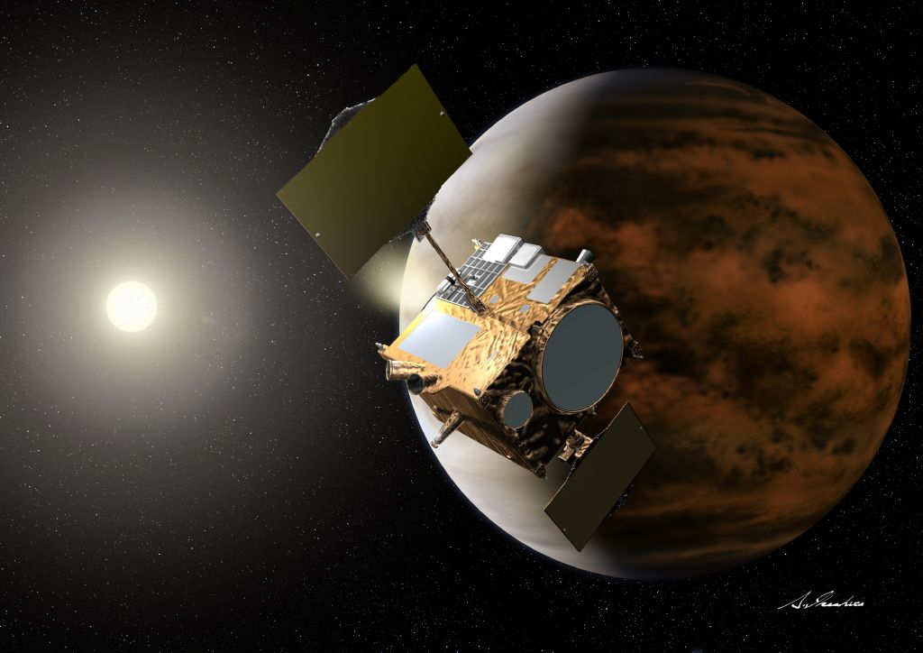
Credit: JAXA/Akihiro Ikeshita
2/11

Slide 3
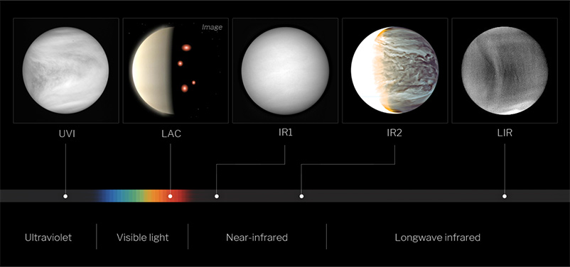
LAC: Lightning and Airglow Camera
Credit: JAXA
3/11

Slide 4
Akatsuki: 1 Flash in 22 Hours over 4 Years
This flash was interpreted as lightning
Other occurrences:
  Radio pulses (Galileo)
  Whistler-mode wave trains (Venus Express)
  Optical flashes (Pirka Photometer)
  We study if a meteor could have caused the flash instead
4/11
Notes:
Whistler mode waves are waves that happen in 10s of milliseconds – Venus express recorded data every dozens of seconds. Venus Express detected what they assumed to be like trains of whistler mode waves, but not actual whistler mode waves (instrument wasn’t too fine for that)

Slide 5
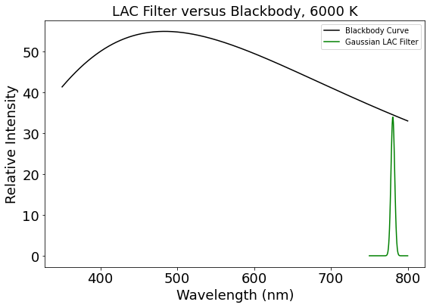
Past Assumption: Meteors = Blackbodies
Blackbody spectrum (6000 K)
Akatsuki LAC Filter
(OI line, optimized
for lightning)
5/11
Notes:
- We assumed the Akatsuki LAC filter to be a Gaussian centered around the O1 peak (green).
- To illustrate, this is the curve of a blackbody (black line) against the LAC filter. The arguments for lightning assume that Akatsuki measured a lightning flash because the energy amount for a blackbody-emitting meteor would be far too large to be realistic.

Slide 6
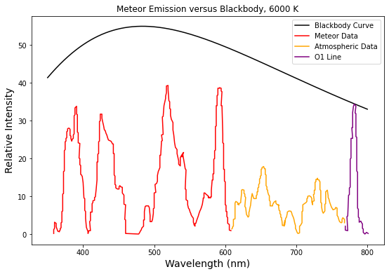
Possible Reality: Meteors ≠ Blackbodies
Blackbody (6000 K)
Mg, Fe, Ni, Ca, Na
Real emission from a
~1 kg meteor spectrum
(Madiedo et al. 2013)
O
N₂
6/11
Notes:
However, smaller meteors emit as spectra, not blackbodies.
This data is from a Geminid meteor that burned up in Earth’s atmosphere. As we can see, the peak of the O1 emission line lines up extremely nicely with the LAC filter. T

Slide 7
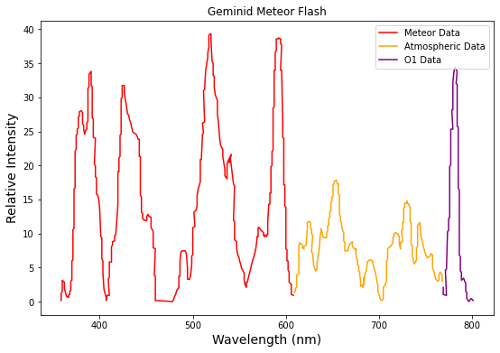
Previous studies underestimated the fraction of optical energy in the LAC filter
Mg, Fe, Ni, Ca, Na
Blackbody assumption:
Oxygen / Total ~ 0.007
But, for this meteor:
Oxygen / Total ~ 0.09
Atmospheric / Total ~ 0.3
O
N₂
7/11
Notes:
To calculate the energy of the meteor, we took the ratio of relative energy in the atmospheric O1 peak (within the LAC filter) to the total energy emitted by the meteor in red, not including the rest of the atmospheric data in yellow.
We found that the conversion rate for energy was around 9% for earth.
On venus, the conversion rate could be up to 30%.

Slide 8
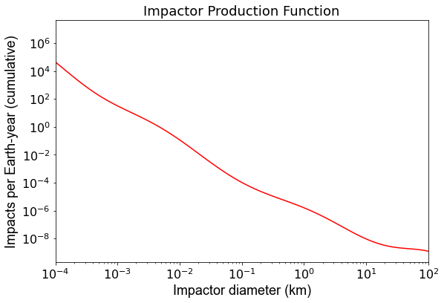
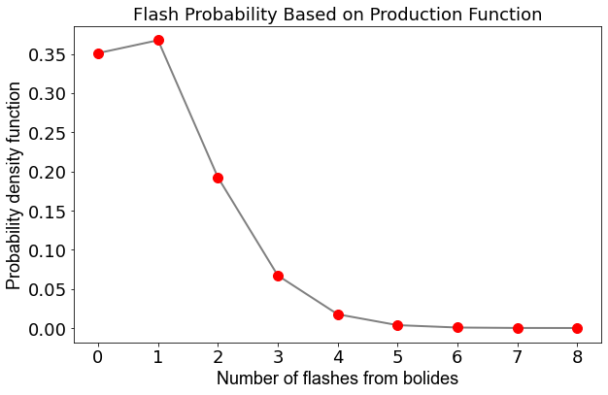
Poisson Statistics: ≥1 flash from a meteor was likely during Akatsuki’s observations
8/11
Notes:
Claims of lightning have been validated because of the one observed flash, but given the rate of conversion of energy, it may be more likely that a meteor caused the observed flashes!

Slide 9
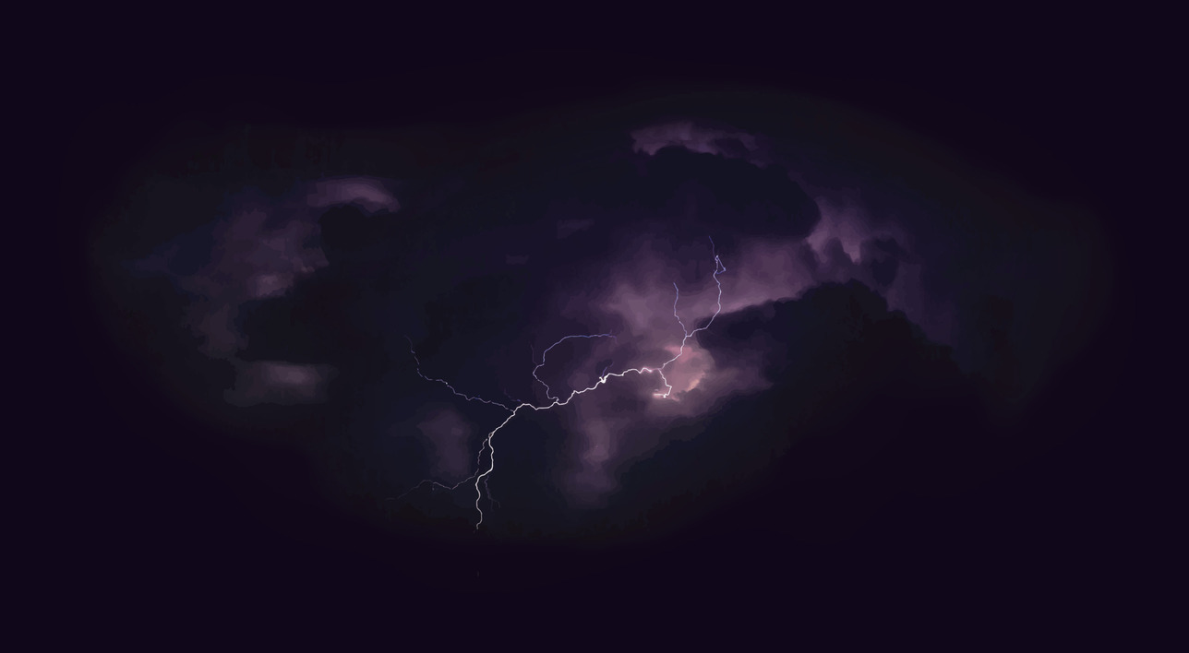
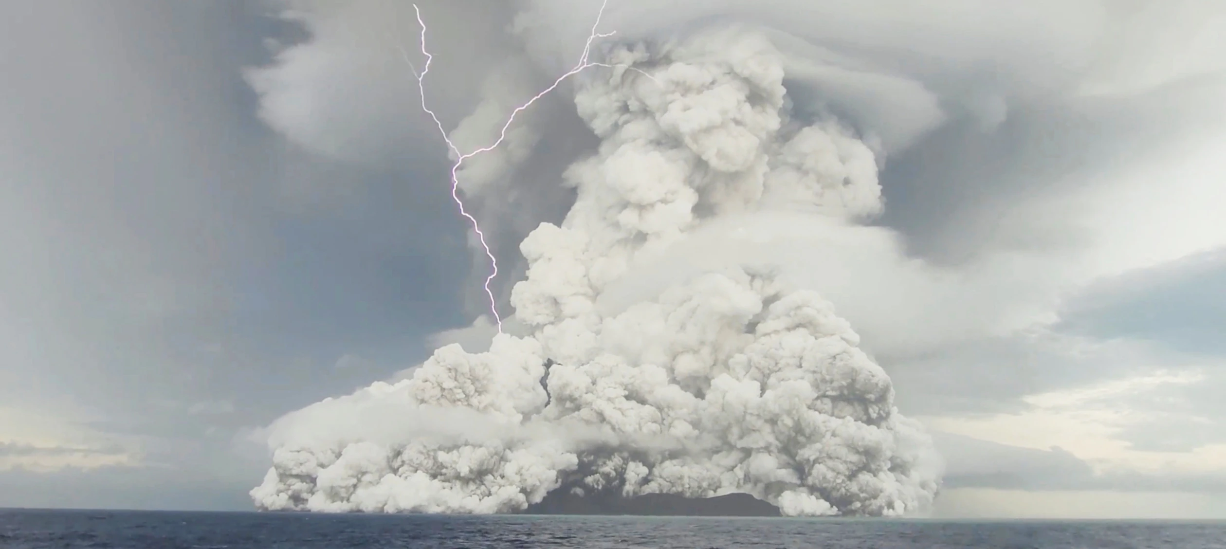
Conclusions
Detected flash(es) may not be due to lightning, but meteor fireballs
Lightning could still occur:
  Volcanic eruptions
  Lower in the cloud layer
Future missions could verify
Credit: Tonga Geological Services, Reuters
9/11
Notes:
Convection patterns
Solid – liquid patterns (how is normal lightning created? )
Lightning can produce a lot of NO – important for cloud chemistry - implications for life?
Exploit EM to perform sounding of crust like on Earth

Slide 10
This work will transition next year to
become my Senior and Honors Thesis Project
Acknowledgements:
Dr. Joseph O’Rourke
ASU/NASA Space Grant
Qichang Zhang (Caltech)
Cover Credit: Mike Eliason, AP
10/11

Slide 11
Thank you!
Reframing Conclusions:
Meteor fireballs at Venus may produce lots of optical emission from atmospheric oxygen like lightning.
Optical flashes detected by the Akatsuki mission could be due to meteors ablating in the atmosphere, not lightning.
11/11

